Slide 1
History
JavaScript was introduced in 1995 as a way to add programs to web pages in the Netscape Navigator browser.
The language has since been adopted by all other major graphical web browsers.
It has made modern web applications possible— applications with which you can interact directly without doing a page reload for every action.
JavaScript is also used in more traditional websites to provide various forms of interactivity and cleverness.
It is important to note that JavaScript has almost nothing to do with the programming language named Java. The similar name was inspired by marketing considerations

Slide 2
Client-Side JavaScript
Client-side JavaScript scripts operate on a client browser.
Detect whether the browser supports a certain plug-in, Control a plug-in
Validate user form input
Prompt a user for confirmation
Perform post-processing of information retrieved from server-side JavaScript
Display error or information boxes
Display confirmation boxes
Process server data, such as aggregate calculations
Add programmable logic to HTML
Perform functions that don’t require information from the server
Produce a new HTML page without making a request to the server

Slide 3
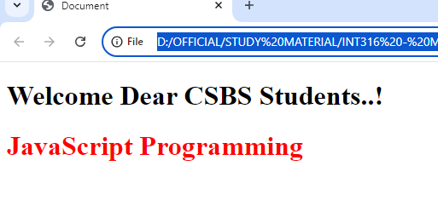
Start JavaScript
<!DOCTYPE html>
<html lang="en">
<head>
<meta charset="UTF-8">
<meta name="viewport" content="width=device-width, initial-scale=1.0">
<title>Document</title>
<script type="text/JavaScript">
document.writeln("<h1>Welcome Dear CSBS Students..!</h1>")
</script>
</head>
<body>
<h1 style="color:red;"> JavaScript Programming</h1>
</body>
</html>
Javascript

Slide 4
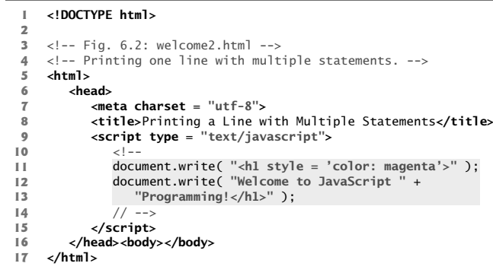
Sample 2

Slide 5
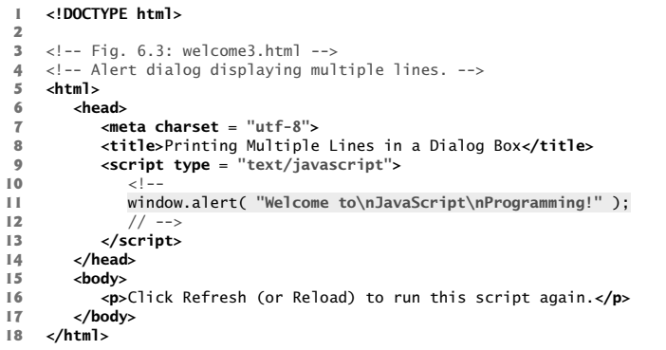
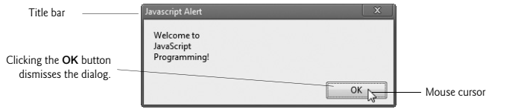
Display Text in an Alert Dialog

Slide 6
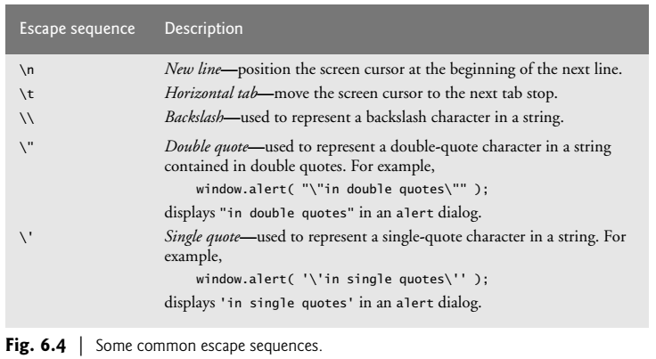
Common escape sequence

Slide 7
JavaScript Placement in HTML File
Script in <head>...</head> section.
<html>
<head>
<script type = "text/javascript">
document.writeln(“welcome CSBS");
</script>
</head>
<body>
….
</body>
</html>
Script in <body>...</body> section
<html>
<head>
</script>
</head>
<body>
<script type = "text/javascript">
document.writeln(“welcome CSBS");
</body>
</html>
Script within <Head>
Script within <Body>
Javascript can be written in <head>, <body> or both in sections, depends on the need

Slide 8
JavaScript given in both <head> & <body>
<html>
<head>
<script type = "text/javascript">
function sayHello() {
alert("Hello World")
}
</script>
</head>
<body>
<script type = "text/javascript">
document.write("Hello World")
</script>
<input type = "button" onclick = "sayHello()" value = "Say Hello" />
</body>
</html>
<html> <head>
<script type = "text/javascript" src = "filename.js" >
</script>
</head>
<body> ... </body>
</html>
External javascript file

Slide 9
Variable Declaration
var name = “Dear";
const greeting = "Hello ";
console.log(greeting + name); // → Hello Dear
The first, var (short for “variable”), is the way bindings were declared in pre-2015 JavaScript.
The word const stands for constant. It defines a constant binding, which points at the same value for as long as it lives

Slide 10
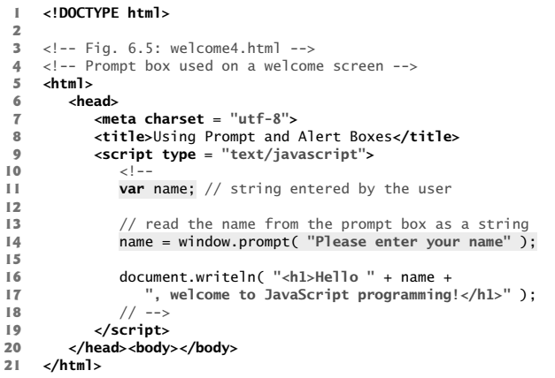
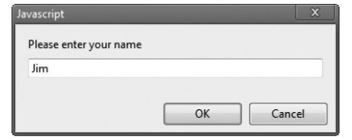
Obtaining user input with prompt Dialog
Variable declaration
String concatenation
Feed input using Prompt

Slide 11
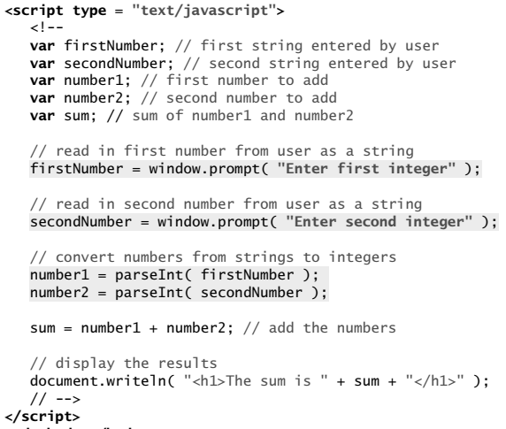
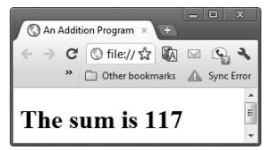
Sample Program
Data Conversion
-- parseInt ()
-- Number ()

Slide 12
Data Types in JavaScript
JavaScript does not require variables to have a declared type
A variable in JavaScript can contain a value of any data type
When variables are declared, they’re not assigned values unless you specify them.
Assigning the value null to a variable indicates that it does not contain a value.
Eg:-
Var a=null ;
There are two special values, written null and undefined, that are used to denote the absence of a meaningful value

Slide 13
Comments
// single-line comment
/* Comment with multiple lines */

Slide 14
Primitive (atomic) values
Booleans:
true false
Numbers:
1.141
-123
The basic number type is used for both floating point numbers (doubles) and integers.
Bigints:
17n -49n

Slide 15
string
The basic number type can only properly represent integers within a range of 53 bits plus sign.
Bigints can grow arbitrarily large in size.
Strings:
You can use single quotes, double quotes, or backticks to mark strings, as long as the quotes at the start and the end of the string match.
'abc'
"abc"
`String with interpolated values: ${256} and ${true}`

Slide 16
string
JavaScript has no extra type for characters. It uses strings to represent them.
Strings cannot be divided, multiplied, or subtracted, but the + operator can be used on them. It does not add, but it concatenates.
The following line will produce the string "concatenate":
con" + "cat" + "e" + "nate“
String values have a number of associated functions (methods) that can be used to perform other operations on them

Slide 17
Automatic type conversion
JavaScript goes out of its way to accept almost any program you give it
console.log(8 * null) // → 0
console.log("5" - 1) // → 4
console.log("5" + 1) // → 51
console.log("five" * 2) // → NaN
console.log(false == 0) // → true
When an operator is applied to the “wrong” type of value, JavaScript will quietly convert that value to the type it needs, using a set of rules
This is called type coercion

Slide 18
Bindings (variables)
How does a program keep an internal state? How does it remember things?
To catch and hold values, JavaScript provides a thing called a binding, or variable.
let caught = 5 * 5;
The special word (keyword) let indicates that this sentence is going to define a binding.
It is followed by the name of the binding and, if we want to immediately give it a value, by an = operator and an expression.
The previous statement creates a binding called caught and uses it to grab hold of the number that is produced by multiplying 5 by 5

Slide 19
Binding names
Binding names can be any word.
Digits can be part of binding names—catch22 is a valid name
But the name must not start with a digit.
A binding name may include dollar signs ($) or underscores (_) but no other punctuation or special characters.
Words with a special meaning, such as let, are keywords, and they may not be used as binding names.
There are also a number of words that are “reserved for use” in future versions of JavaScript, which also can’t be used as binding names.

Slide 20
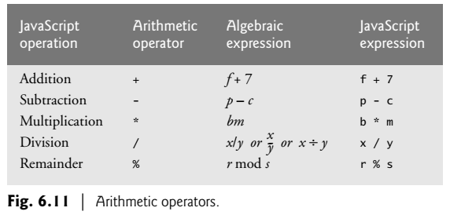
Arithmetic Operators

Slide 21
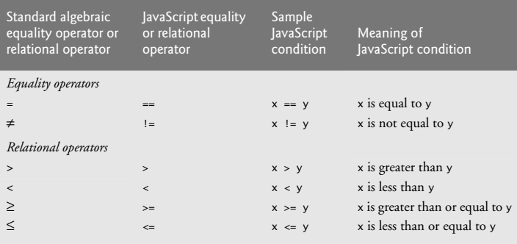
Equality and Relational Operators

Slide 22
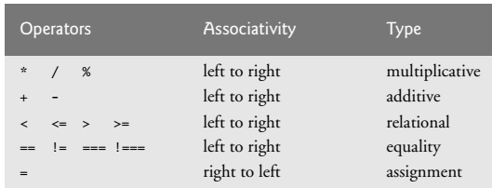
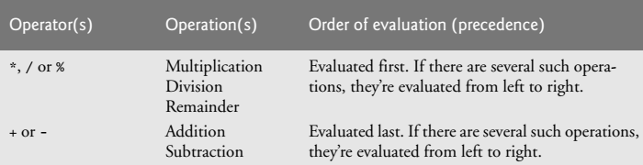
Precedence and associativity of operators

Slide 23
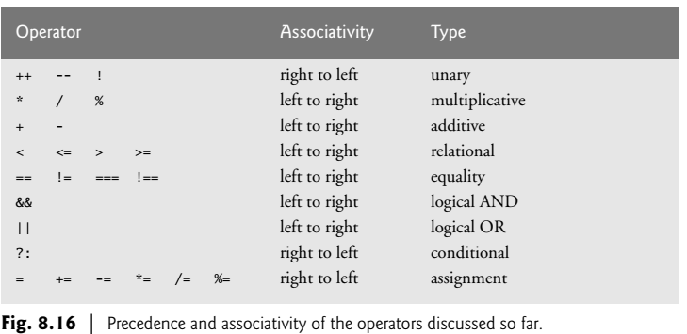
Precedence and associativity of operators

Slide 24
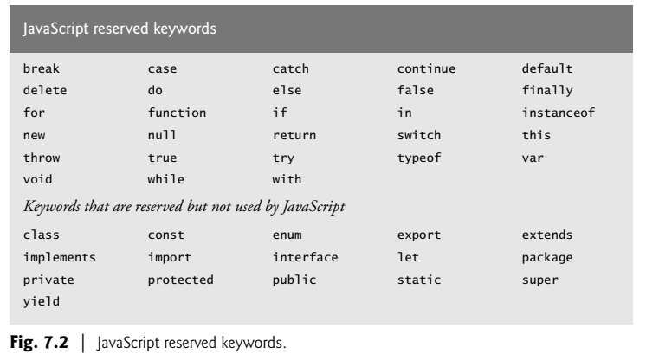
Reserved Key Words

Slide 25
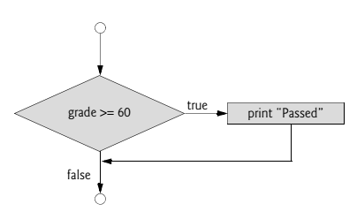
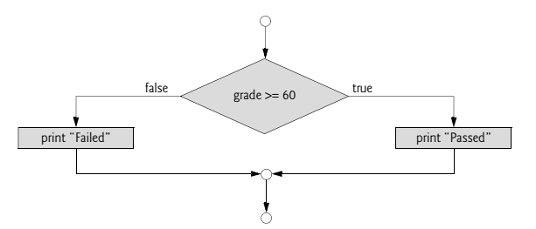
control statements
if ( studentGrade >= 60 ) document.writeln( "<p>Passed</p>" );
If (studentGrade >= 60)
document.writeln( "<p>Passed</p>" );
Else
document.writeln( "<p>Failed</p>" );

Slide 26
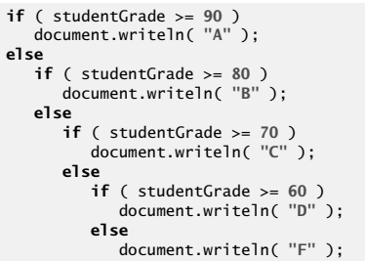
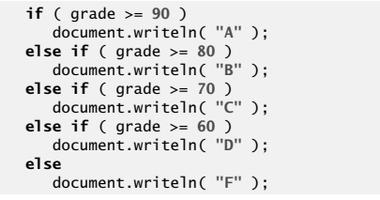
Control Statements

Slide 27
Sample JavaScript Programming
<!DOCTYPE html>
<html lang="en">
<head>
<script type="text/javascript">
var name,rlno,m1,m2,total;
name=window.prompt('enter your name');
rlno=window.prompt('enter your rlno');
m1=parseInt(window.prompt('enter your mark1:'));
m2=parseInt(window.prompt('enter your mark2:'));
total=m1+m2;
document.writeln("<h1 style=color:blue;>Student Details:</h1>");
document.writeln("<h2 style=color:brown;>Rlno:"+ rlno +"</h2>");
document.writeln("<h2 style=color:brown;>Name:"+name +"</h2>");
document.writeln("<h2 style=color:brown;>Total:"+ total +"</h2>");
if(m1>=50 && m2>=50)
document.writeln("<h2 style=color:brown;>Result:Passed</h2>");
else
document.writeln("<h2 style=color:brown;>Result:Failed</h2>");
</script>
</head>
<body>
</body>
</html>

Slide 28
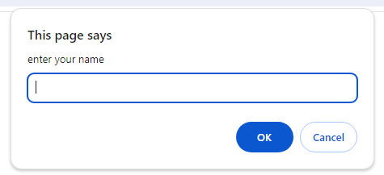
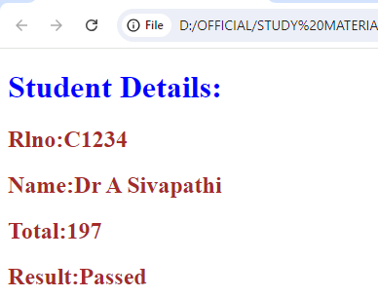
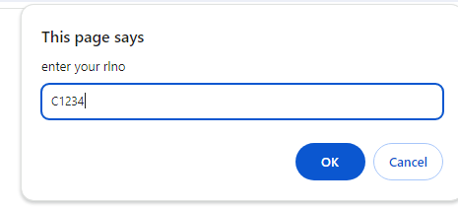
Output

Slide 29
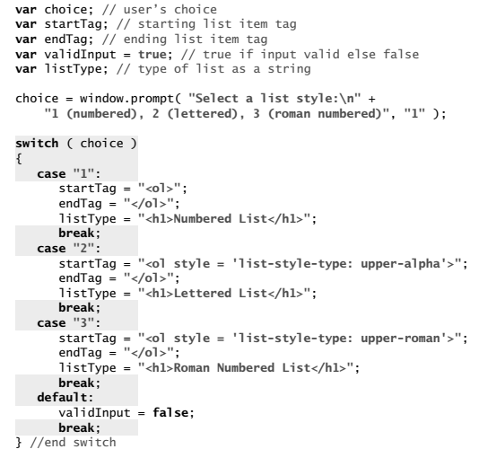
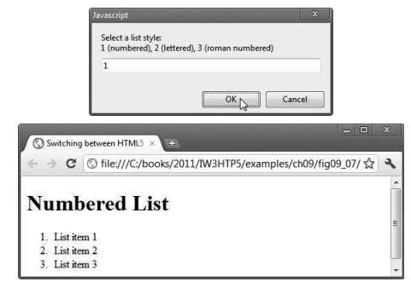
Switch Case

Slide 30
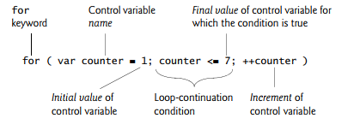
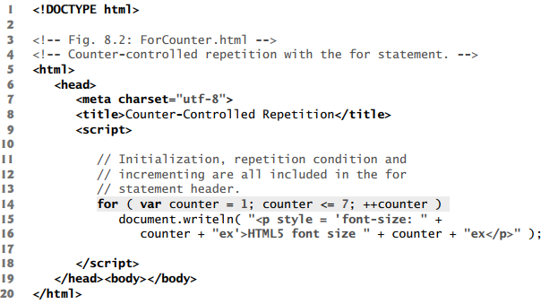
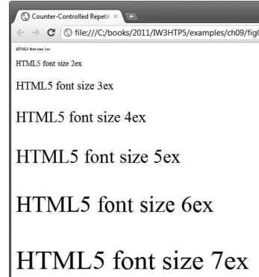
for Repetition Statement

Slide 31
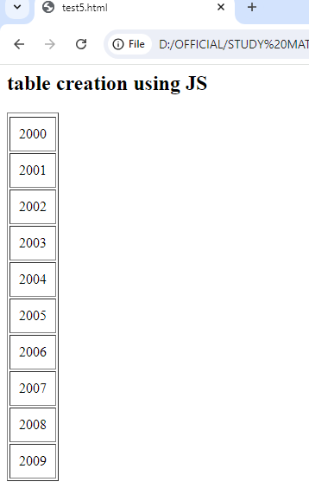
Using Loop – Generate Table
<!DOCTYPE html>
<html lang="en">
<head>
<script>
var i=0;
document.writeln('<h2>table creation using JS</h2>');
document.writeln('<table border=1><tr>');
for(i=2000;i<2010;i++)
document.writeln(“<tr><td style=padding:10px;>" + i + "</td></tr>");
</script>
</head>
<body>
</body>
</html>

Slide 32
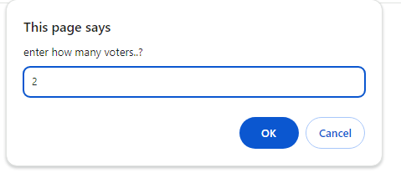
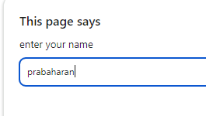
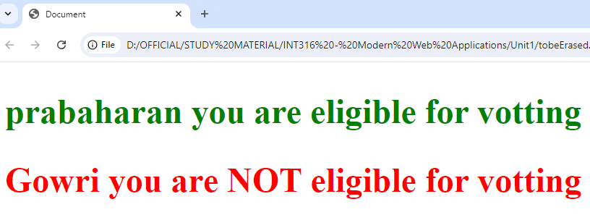
Get ‘N’ voters and check their eligibility
<!DOCTYPE html>
<html lang="en">
<head>
<meta charset="UTF-8">
<meta name="viewport" content="width=device-width, initial-scale=1.0">
<title>Document</title>
</head>
<body>
<script type="text/javascript">
var i,name,age,n;
n=Number(window.prompt('enter how many voters..?'));
for(i=0;i<n;i++){
name=window.prompt('enter your name');
age=Number(prompt('enter your age'));
if(age>=18)
document.writeln('<h2 style=color:green>' + name + ' you are eligible for votting </h1>');
else
document.writeln('<h2 style=color:red>' + name + ' you are NOT eligible for votting </h1>');
}
</script>
</body>
</html>

Slide 33
do…while Repetition Statement
<!DOCTYPE html>
<html lang="en"> <head>
</head>
<body>
<script>
document.writeln('<table>');
document.writeln('<tr><th> slno </th> <th> value </th>');
var counter=1;
do{
document.writeln('<tr><td>' + counter + '</td>' +
'<td>' + counter * 115 + /td></tr>');
counter++;
} while(counter<5)
document.writeln('</tr></table>');
</script>
</body> </html>
<style>
table{
width: 300px;
border-collapse: collapse;
background-color: lightblue;
}
table,td,th{
border: 1px solid black;
padding: 4px;
}
th{text-align: center;
color: white;
background-color: darkblue;}
tr.oddrow{background-color: white;}
</style>

Slide 34
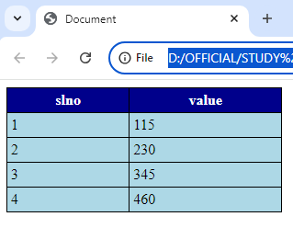
Output of previous program

Slide 35
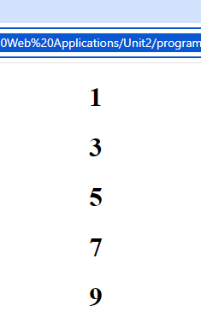
While loop
<!DOCTYPE html>
<html lang="en">
<head>
<title>Document</title>
</head>
<body>
<script>
var count = 1;
while (count < 10)
{ document.writeln('<center><h1>' + count + '</h1></center>');
count +=2;
}
</script>
</body> </html>

Slide 36
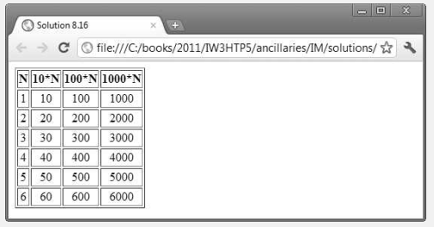
Exercise
Write a script that uses looping to print the following table of values. Output the results in an HTML5 table. Use CSS to center the data in each column.

Slide 37
Break and Continue
In addition to the selection and repetition statements, JavaScript provides the statements break and continue to alter the flow of control
break Statement
The break statement, when executed in a while, for, do…while or switch statement, causes immediate exit from the statement. Execution continues with the first statement after the structure
continue Statement
The continue statement, when executed in a while, for or do…while statement, skips the remaining statements in the body of the statement and proceeds with the next iteration of the loop

Slide 38
JavaScript - Function
Functions allow a programmer to divide a big program into a number of small and manageable functions.
Syntax:
function functionName (parameter-list)
{ statements }
<!DOCTYPE html>
<html lang="en">
<head>
<script>
function display()
{
document.writeln('Welcome CSBS students..!');
}
display(); // calling of function
</script>
</head>
<body>
</body>
</html>
No need to specify return type
No need of ‘var’ keyword for parameter
declaration

Slide 39
Function parameters and return
<!DOCTYPE html>
<html lang="en">
<head>
<script>
function checkEligibility(age)
{
if(age>=18)
return "Eligible for Vote";
else
return "Not Eligible for Vote";
}
</script>
</head>
<body>
<script>
var age;
age=parseInt(prompt('enter your age'));
document.writeln('you are ' + checkEligibility(age));
</script>
</body>
</html>
Calling of function and
Returns a value

Slide 40
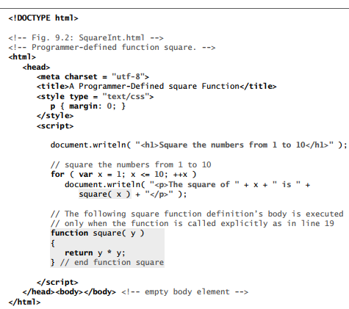
Function assignment
Function definition

Slide 41

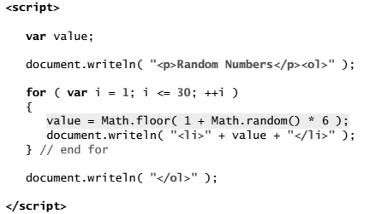
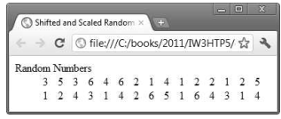
Math function

Slide 42
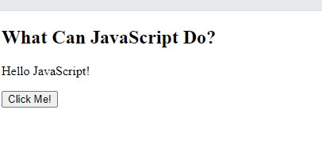
JS with Button Event
<!DOCTYPE html>
<html>
<body>
<h2>What Can JavaScript Do?</h2>
<p id="demo">JavaScript can change HTML content.</p>
<button type="button" onclick='document.getElementById("demo").innerHTML = "Hello JavaScript!"'>
Click Me!
</button>
</body>
</html>
Inline JavaScript
After clicking button

Slide 43
Button with inline function call
<!DOCTYPE html>
<html lang="en">
<head> </head>
<body>
<h1 id="h1Tag">Add Event Listener Program Sample </h1>
<form action="#">
<button id="btn" onclick="changeVal()">click here</button>
</form>
<script type="text/javascript">
function changeVal()
{
document.getElementById("h1Tag").innerHTML="Content changed using inline function call";
}
</script>
</body>
</html>
The # symbol by itself represents the current page.

Slide 44
Button with AddEventListener
<!DOCTYPE html>
<html lang="en">
<head> </head>
<body>
<h1 id="h1Tag">Add Event Listener Program Sample </h1>
<form action="#">
<button id="btn">click here</button>
</form>
<script type="text/javascript">
function changeVal()
{
document.getElementById("h1Tag").innerHTML="Content changed using EventListener";
}
document.getElementById("btn").addEventListener("click",changeVal);
</script>
</body>
</html>
The # symbol by itself represents the current page.
A function can be
Called using Event Listener

Slide 45
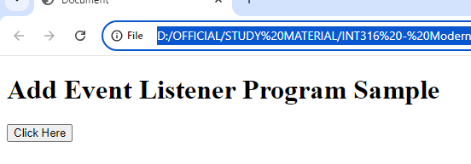
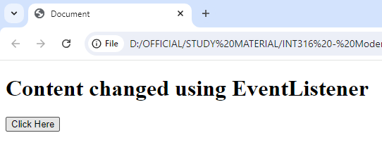
Output of Previous Program
This is a sample code to change the
Content of <h1> tag by clicking button;
Using AddEventListener
Before button click
After
button click

Slide 46
Access element’s property
<!DOCTYPE html>
<html>
<body>
<h2>What Can JavaScript Do?</h2>
<p id="demo">JavaScript can change the style of an HTML element.</p>
<button type="button" onclick="document.getElementById('demo').style.fontSize='35px'">Click Me!</button>
</body>
</html>

Slide 47
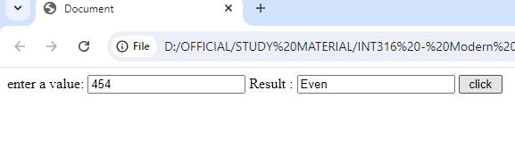
Check Odd/Even
<!DOCTYPE html>
<html lang="en">
<head>
<meta charset="UTF-8">
<meta name="viewport" content="width=device-width, initial-scale=1.0">
<title>Document</title>
<script>
function myfunction()
{
var a = parseInt(document.getElementById("txt1").value);
if (a%2==0)
document.getElementById("txt2").value="Even";
else
document.getElementById("txt2").value="Odd";
}
</script>
</head>
<body>
enter a value: <input type="text" id="txt1">
Result : <input type="text" id="txt2">
<input type="button" value=" click " onclick="myfunction();">
</body>
</html>

Slide 48
Retrieve values from forms - JS
<!DOCTYPE html>
<html lang="en">
<head> </head>
<body>
<label for="txtName">Enter your Name </label>
<input type="text" id="txtName" value="enter Name"><br><br>
<label for="radio">Select Your Course </label>
<input type="radio" id="course1" name ="Course" value="B.Tech">B.Tech</input>
<input type="radio" id="course2" name ="Course" value="M.Tech">M.Tech</input>
<input type="radio" id="course3" name ="Course" value="MCA">MCA</input><br><br>
<label for="check">Your Next Goal</label>
<input type="checkbox" id="goal1" name ="Goal" value="Job">Placement</input>
<input type="checkbox" id="goal2" name ="Goal" value="Research">Research</input><br><br>
<label for="txarea">List of Names </label>
<textarea id="txarea"></textarea>
<button id="btn4"> Add Name to List </button>

Slide 49
Retrieve values from forms - JS
<script>
var txt=document.getElementById("txtName");
var txarea=document.getElementById("txarea");
var rdbutton= document.getElementsByName("Course");
var chkGoal= document.getElementsByName("Goal");
function addNames()
{
var radioVal,chkVal='';
for(var i=0;i<rdbutton.length;i++)
if(rdbutton[i].checked)
radioVal=rdbutton[i].value;
for(i=0;i<chkGoal.length;i++)
if(chkGoal[i].checked)
chkVal=chkVal + ',' + chkGoal[i].value;
txarea.textContent=txarea.textContent + '\n'+ txt.value + '\n doing ' +
radioVal + ' at SASTRA would like to do \n'+ chkVal;
}
document.getElementById("btn4").addEventListener("click",addNames);
</script>
</body> </html>

Slide 50
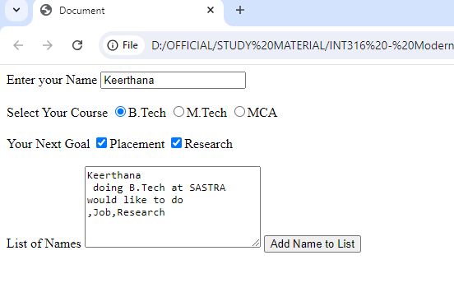
Retrieve values from forms - JS

Slide 51
Arrays
var arrval=[10,20,30];
arrval.length; → 3
Array pop(): to remove values into array
Array push() : to push values into array
Arrays are data structures consisting of related data items. JavaScript arrays are “dynamic” entities in that they can change size after they’re created

Slide 52
Arrays
function arrayInsertion()
{ var para = document.getElementById('pg1');
para.textContent=''
var str1=window.prompt('enter a value to be added in the array');
arrval.push(str1);
for(i=0;i<arrval.length;i++)
para.textContent=para.textContent + ' ' + arrval[i];
}
function arraySearch(){
var para = document.getElementById('pg1');
searchVal=parseInt(window.prompt('enter a value to be searched'));
for(i=0;i<arrval.length;i++)
{
if(arrval[i]==searchVal)
{ para.textContent='the element found';break;}
else
para.textContent='the element not found';
}
}

Slide 53
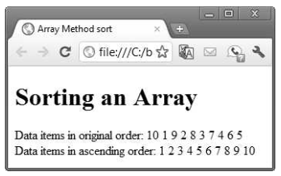
Arrays
It’s also possible to reserve a space in an array for a value to be specified later by using a comma as a place holder in the initializer list.
var n = [ 10, 20, , 40, 50 ];
Write a JS code to get values using Arrays
Sorting an Array

Slide 54
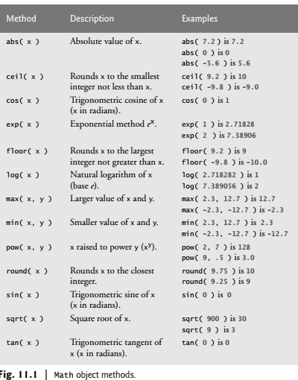
JavaScript Objects
The Math object’s methods enable you to conveniently perform many common mathematical calculations var result = Math.sqrt( 900 );

Slide 55
String Methods
String Methods
Method Description
charAt() Returns the character at the specified index (position)
charCodeAt() Returns the Unicode of the character at the specified index
concat() Joins two or more strings, and returns a new joined strings
endsWith() Checks whether a string ends with specified string/characters
fromCharCode() Converts Unicode values to characters
includes() Checks whether a string contains the specified string/characters

Slide 56
String Object
Method Description
indexOf() Returns the position of the first found occurrence of a specified value in a string
lastIndexOf() Returns the position of the last found occurrence of a specified value in a string
match() Searches a string for a match against a regular expression, and returns the matches
repeat() Returns a new string with a specified number of copies of an existing string
replace() Searches a string for a specified value, or a regular expression, and returns a new string where the specified values are replaced

Slide 57
String Methods
Method Description
search() Searches a string for a specified value, or regular expression, and returns the position of the match
slice() Extracts a part of a string and returns a new string
split() Splits a string into an array of substrings
startsWith() Checks whether a string begins with specified characters
substr() Extracts the characters from a string, beginning at a specified start position, and through the specified number of character
substring() Extracts the characters from a string, between two specified indices

Slide 58
String Methods
Method Description
toLowerCase() Converts a string to lowercase letters
toString() Returns the value of a String object
toUpperCase() Converts a string to uppercase letters
trim() Removes whitespace from both ends of a string
valueOf() Returns the primitive value of a String object

Slide 59
Date Object
The Date object is used to work with dates and times.
Date objects are created with new Date().
There are four ways of instantiating a date:
var d = new Date();
var d = new Date(milliseconds);
var d = new Date(dateString);
var d = new Date(year, month, day, hours, minutes, seconds, milliseconds);

Slide 60
Date Object
Date Object Methods
Method Description
getDate() Returns the day of the month (from 1-31)
getDay() Returns the day of the week (from 0-6)
getFullYear() Returns the year
getHours() Returns the hour (from 0-23)
getMilliseconds() Returns the milliseconds (from 0-999)
getMinutes() Returns the minutes (from 0-59)
getMonth() Returns the month (from 0-11)
getSeconds() Returns the seconds (from 0-59)
getTime() Returns the number of milliseconds since midnight Jan 1 1970, and a specified date

Slide 61
Method Description
setMinutes() Set the minutes of a date object
setMonth() Sets the month of a date object
setSeconds() Sets the seconds of a date object
setTime() Sets a date to a specified number of milliseconds after/before January 1, 1970
setUTCDate() Sets the day of the month of a date object, according to universal time
setUTCFullYear() Sets the year of a date object, according to universal time
setUTCHours() Sets the hour of a date object, according to universal time
setUTCMilliseconds() Sets the milliseconds of a date object, according to universal time

Slide 62
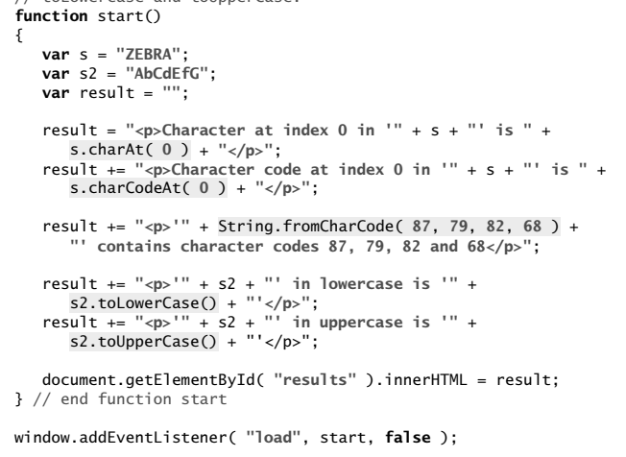
String Objects

Slide 63
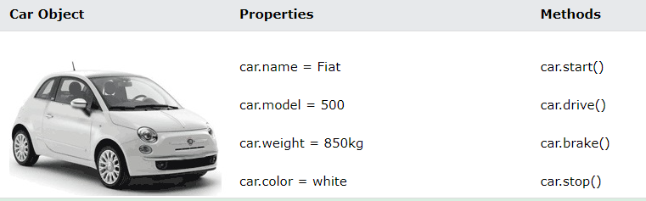
Javascript Objects
JavaScript Objects
Objects are variables too. But objects can contain many values.
This code assigns many values (Fiat, 500, white) to an object named car:
Syntax
const car = {type:"Fiat", model:"500", color:"white"};

Slide 64
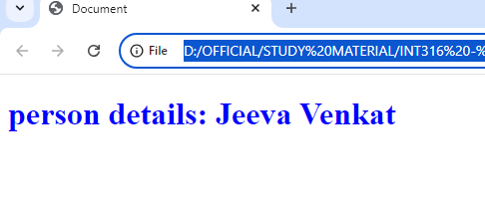
Example Code
JS Object
script>
const person={};
person.firstname='Jeeva';
person.lastname='Venkat';
document.writeln('<h1 style=color:blue;> person details:\n' +
person.firstname +'\n'+ person.lastname + '</h1>');
</script>
person.firstname=prompt('enter Your firstName');
person.lastname=prompt('enter Your lastName');

Slide 65
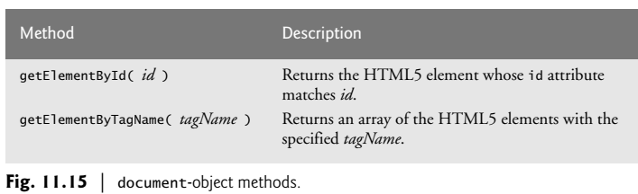
document Object

Slide 66
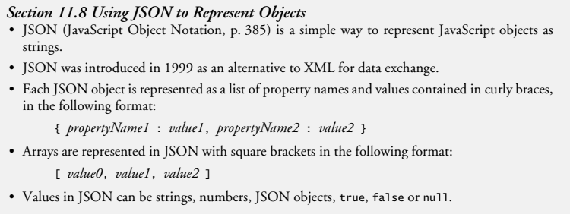
JSON

Slide 67
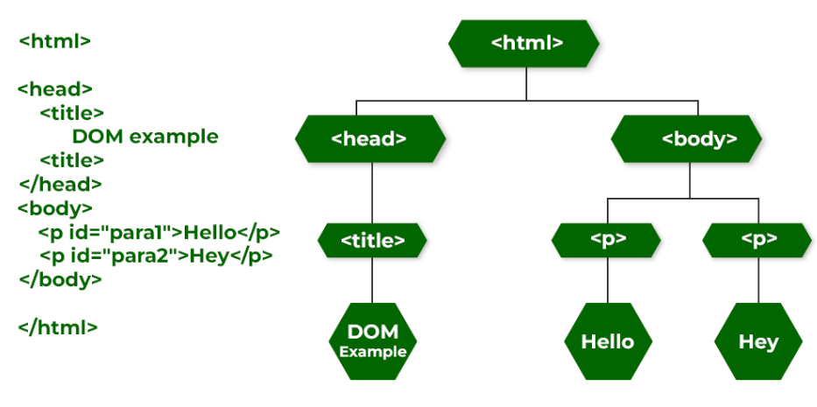
DHTML with JavaScript
DHTML stands for Dynamic HTML.
Dynamic : the content of the web page can be customized or changed according to user inputs.
DHTML included JavaScript along with HTML and CSS to make the page dynamic.
Document Object Modeling (DOM)
<h1> welcome CSBS </h1>
<p id = “p1"> Hello Students..! </p>
<script> document.getElementById(“p1").innerHTML = “example for DOM“ ; </script>

Slide 68
Add, Remove elements in document using DOM
<body>
<h1 id="h1tag"> welcome to CSBS - Demo on Dynamic Style Application</h1>
<button id="btn">Remove H1</button> <button id="btn_add">Add H1</button>
<script>
function changeBGcolor() {
var inputColor = prompt("Enter a color name for the " + "background of this page", "" );
document.body.setAttribute( "style","background-color: " + inputColor ); }
function removeH1Tag() {
const ele=document.getElementById('h1tag');
ele.remove(); }
function addH1tag() {
var el=document.createElement("h1");
el.setAttribute('id','h1tag');
el.textContent='this is new element added';
document.body.appendChild(el); }
window.addEventListener( "load", changeBGcolor, false );
var btn=document.getElementById("btn");
btn.addEventListener( "click", removeH1Tag, false );
var btnadd=document.getElementById("btn_add");
btnadd.addEventListener( "click", addH1tag, false ); </script> </body>

Slide 69


Add label, Textbox, button - DOM
<script>
function start(){
const lable = document.createElement("label");
lable.innerHTML = "Type your Name:";
const txtbox = document.createElement("input");
txtbox.type = "text";
txtbox.value = 'enter a text';;
const btn = document.createElement('button');
btn.innerHTML='Submit';
document.body.appendChild (lable);
document.body.appendChild (txtbox);
document.body.appendChild (btn);
btn.addEventListener("click", prog1);
}
function prog1()
{ window.alert('button clicked'); }
window.addEventListener( "load", start, false );
</script>

Slide 70


Swap two values - DOM
<body>
<script>
var labl1 = document.createElement('label');
labl1.innerHTML="enter a text 1";
var txt1=document.createElement('input');
var labl2 = document.createElement('label');
labl2.innerHTML="enter a text 2";
var txt2=document.createElement('input');
var btn=document.createElement('button');
btn.innerHTML='Swap Values';
document.body.appendChild(labl1);
document.body.appendChild(txt1);
document.body.appendChild(labl2);
document.body.appendChild(txt2);
document.body.appendChild(btn);
function swap() {
var temp=txt1.value;
txt1.value=txt2.value;
txt2.value=temp; }
btn.addEventListener("click",swap);
</script>
</body>
Before swap
After swap

Slide 71


Change text color - DOM
<!DOCTYPE html>
<html lang="en"> <head> </head>
<body> <H1>CHANGE TEXT COLOR USING - DOM </H1>
<SCript>
var label1=document.createElement('label');
label1.innerHTML="enter a color name";
document.body.appendChild (label1);
var txt1=document.createElement ('input');
document.body.appendChild (txt1);
var btn=document.createElement ('button');
btn.innerHTML="changeColor";
document.body.appendChild (btn);
btn.addEventListener("click", changeColor);
function changeColor(){
txt1.style.color=txt1.value;
btn.style.background='yellow';
}
</SCript>
</body>
</html>
Before
After

Slide 72

Add DropDown – using DOM
<!DOCTYPE html>
<html lang="en">
<head> </head>
<body>
<script>
function addOption() {
var dd = document.createElement("select");
for(var i=2020;i<2040;i++)
{
var op1 = document.createElement("option");
op1.value = i;
op1.text = i;
dd.appendChild(op1);
}
document.body.appendChild(dd);
}
addOption();
</script>
</body> </html>

Slide 73
Add Text into DD - DOM
<!DOCTYPE html>
<html lang="en">
<head> </head>
<body>
<script>
var labl=document.createElement("label");
labl.innerHTML="enter a City ";
var txt=document.createElement('input');
var labl2=document.createElement("label");
labl2.innerHTML=" City: ";
var dd=document.createElement("select");
var btn=document.createElement("button");
btn.innerHTML="Add to DD";
function addCity() {
var opt=document.createElement("option");
opt.value=txt.value;
opt.text=txt.value;
dd.appendChild(opt);
}
document.body.appendChild(labl);
document.body.appendChild(txt);
document.body.appendChild(labl2);
document.body.appendChild(btn);
document.body.appendChild(dd);
btn.addEventListener("click",addCity);
</script>
</body>
</html>
The City entered in the textbox will be added
To DropDown (selection) by Button Click

Slide 74

Output for previous program
The City entered in the textbox will be added
To DropDown (selection) by Button Click

